Slide 1
Washington/Baltimore High Intensity Drug Trafficking Areas (W/B HIDTA)
Law Enforcement

Slide 2
What is ODMAP?
The Overdose Detection Mapping Application Program (ODMAP) provides
Near real-time suspected overdose surveillance data across jurisdictions to support public health and public safety efforts
Facilitates near real-time data sharing and timely responses to changes in overdose patterns such as a sudden increase, or spike in overdose events

Slide 3
ODMAP Levels
ODMAP Level 1
ODMAP Level 2
Entering suspected overdoses
Managing suspected overdoses
Agency Management
Spike Alert Management
ODFORM
MOU Management
National Map
Ability to analyze data

Slide 4
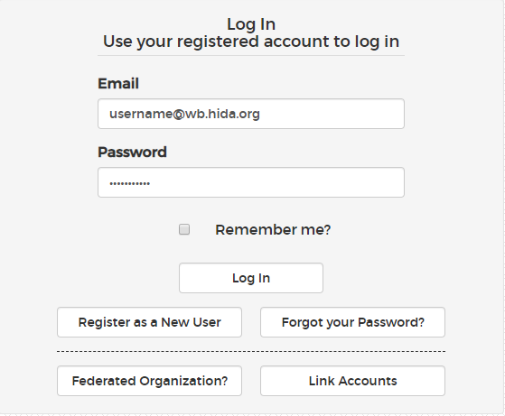
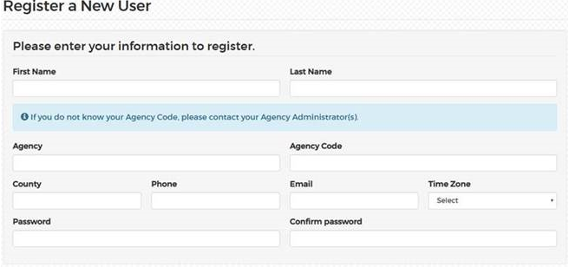
How to register – ODMAP New Level 1
Navigate to: https://https://odmap.hidta.org/
Click: Register as a new user
Enter all your information
Your agency code is required – if you do not know your agency code, please contact the agency administrator
Scroll ALL the way to bottom and click register

Slide 5
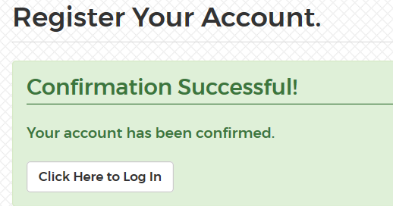
How to register – ODMAP New Level 1
Once you click register, you will receive a confirmation page
Check your email to confirm your account
All new Level 1 users must be approved by their assigned agency administrator(s)
Once an assigned agency administrator(s) has approved a new user, an e-mail with login instructions will be sent to the user requesting access

Slide 6
How to Link ODMAP to Federated Organization
Once linked, you will see ODMAP Level 2 on your Level 1 taskbar
Users that have a separate login for Level 1 and Level 2, will be able to link their accounts

Slide 7
How to enter a suspected overdose

Slide 8
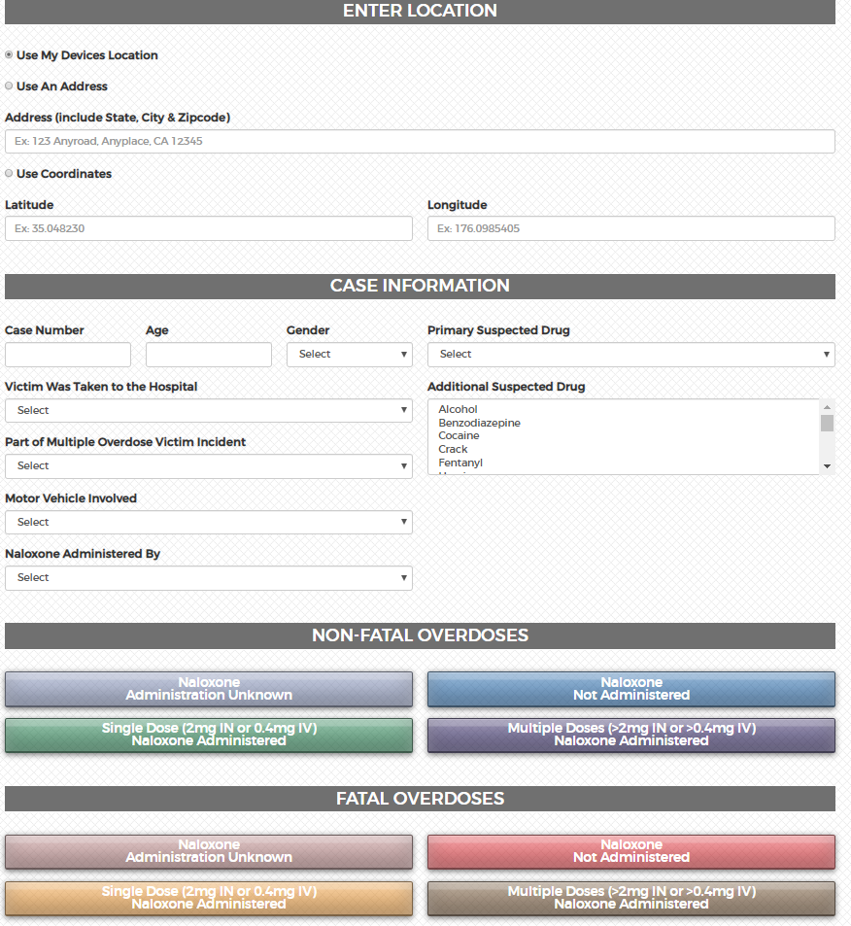
Level 1
3 options for entering location
Optional Case Information Section
One-click selection

Slide 9
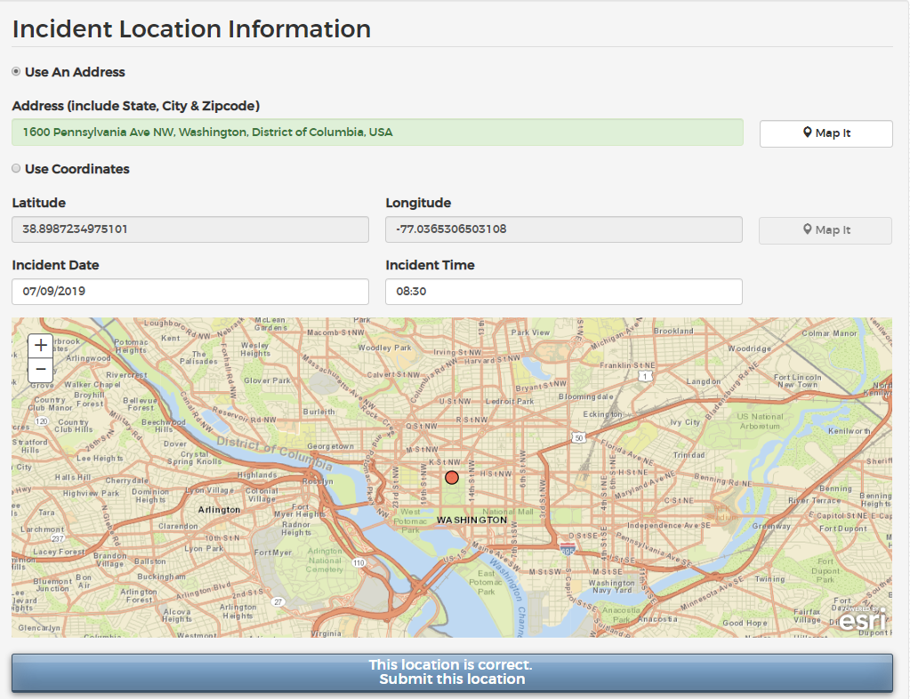
Confirming entry point
Clicking the “Map it” Button allows the user to view the location before submitting
The date and time fields automatically show the current date/time only if a user has used current location. If an address or coordinates are entered the date/time fields are blank.
The user may edit the date and time prior to submitting the incident

Slide 10
Successful Submission
You will receive a successful submission notification
A user may now enter another incident or complete an ODFORM

Slide 11
Duplicate Entry Notification
Once a user clicks on the box verifying the point is the correct one, the system will check for any existing overdoses that are within 285 feet and 1 hour of the overdose they are attempting to save
If there are any matches (the system matches on ALL records, not just the ones the user has submitted), it will return a warning message with the contact info from the other user(s) and asks if they want to still submit the point.
Click YES Submit this location
This same check occurs when a record is being edited

Slide 12
Case Explorer
ODFORM
Case Explorer: It is a separate secure system and functions as a deconfliction system. It also serves as a pointer index system, alerting law enforcement officers if they share a common case element
ODFORM can only be accessed if you have a Case Explorer account
Case Explorer is only for law enforcement users
ODFORM cannot be used until a suspected overdose is submitted to ODMAP
Data entered into ODFORM is not stored in ODMAP. It is automatically sent to Case Explorer.
No Personally Identifiable Information (PII) or Protected Health Information (PHI) information is stored into ODMAP

Slide 13
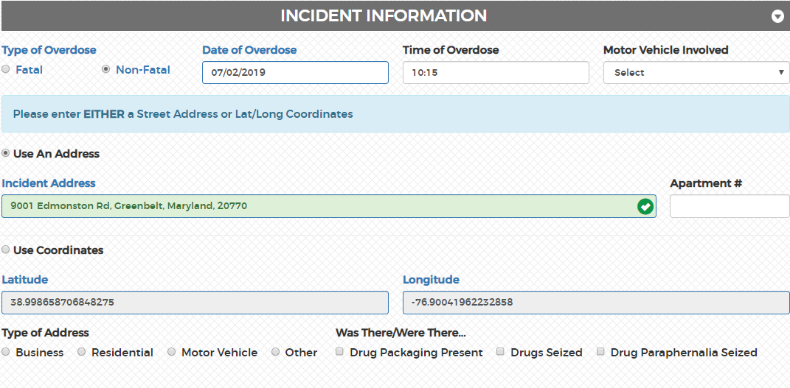
Case Explorer - ODFORM

Slide 14
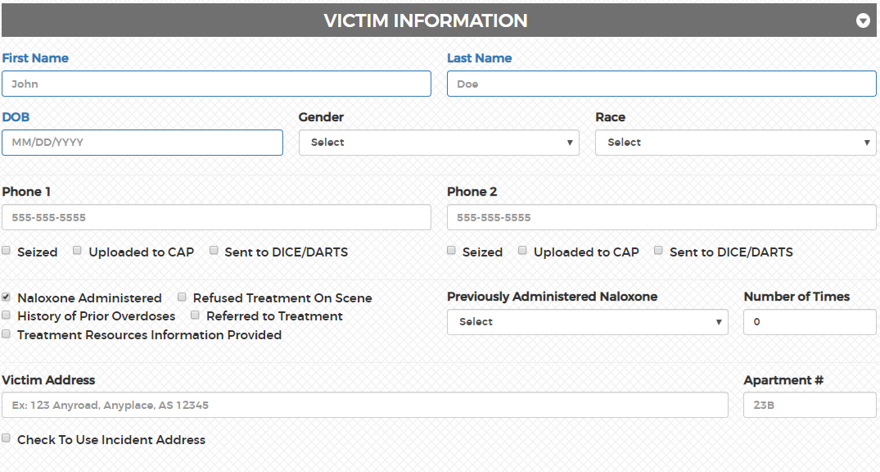
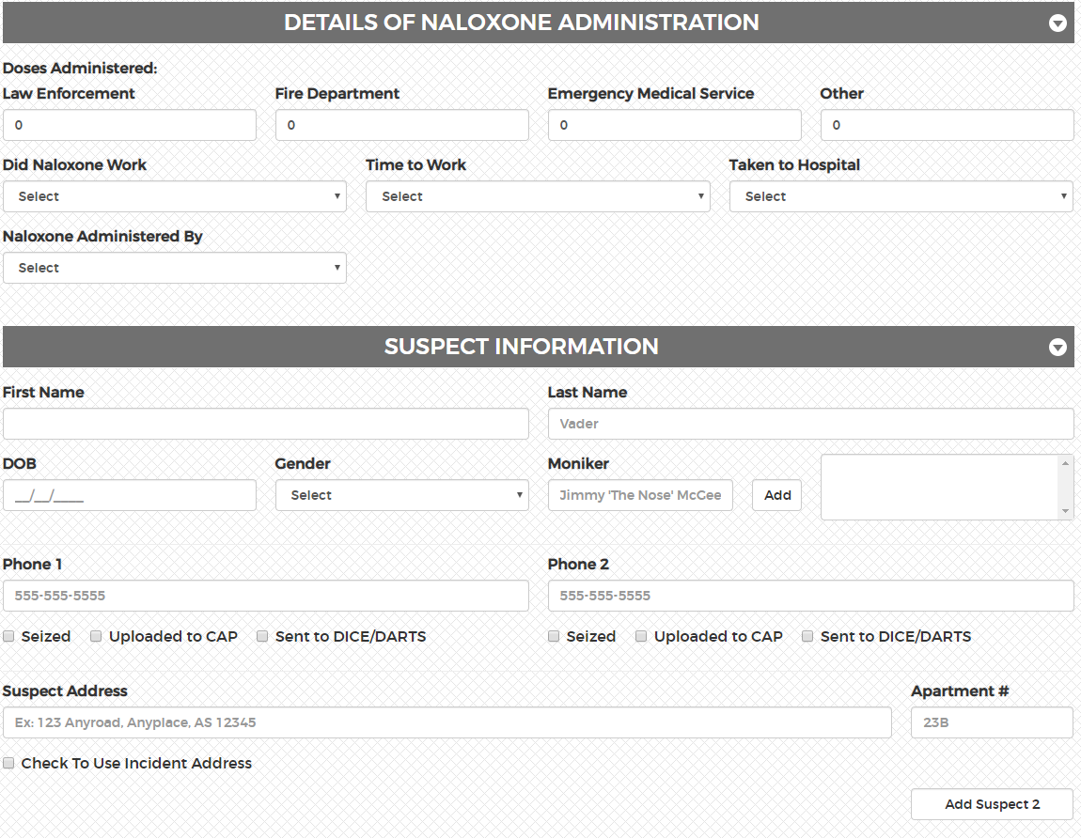

Slide 15
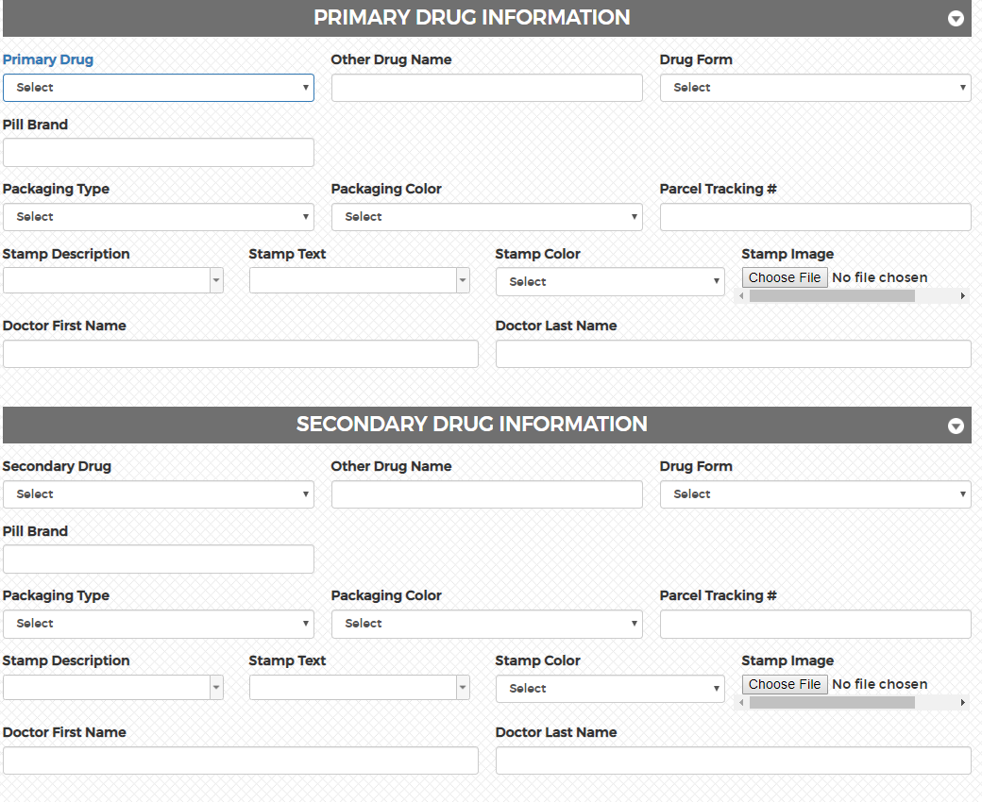

Slide 16
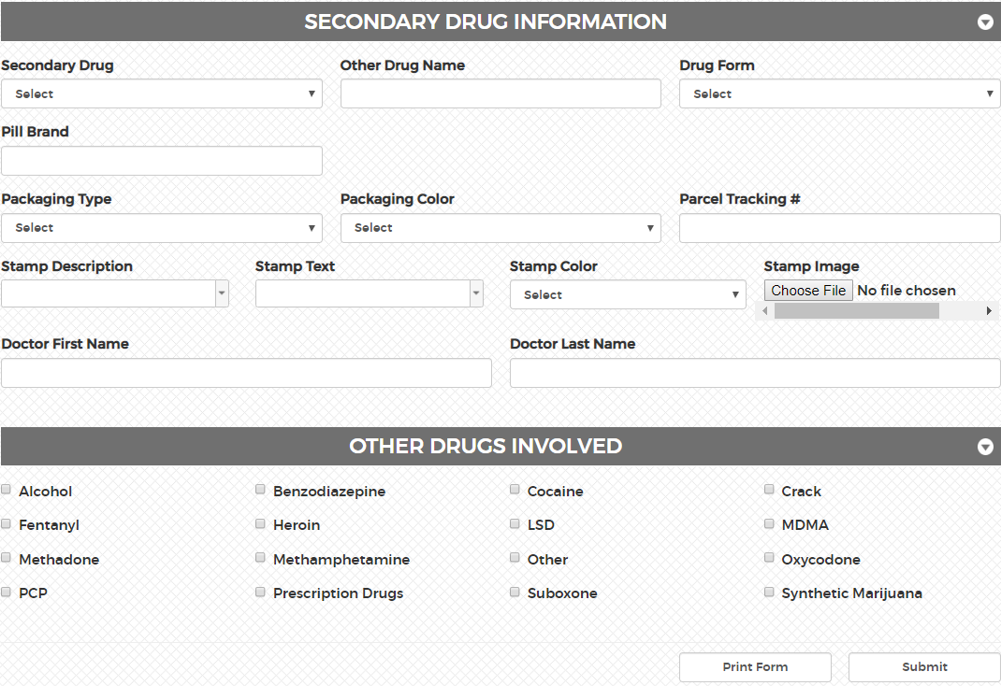

Slide 17
If a user is using the ODFORM they will not be able to edit in ODMAP Level 1 "Manage Overdoses"
Please edit ODFORM through Case Explorer
Contact the ODMAP team to edit the point through Level 1

Slide 18
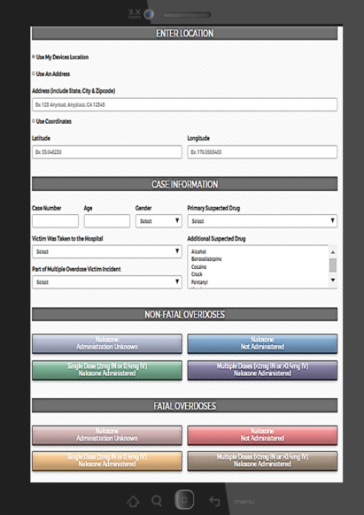
How to use ODMAP at a scene
If a user is using ODMAP though their vehicle:
First responders may create a shortcut to the website through mobile phones and tablets. Please visit https://www.youtube.com/watch?v=qQSzWjl8fRk to learn how. Users are also able to access ODMAP through their Mobile Desktop Terminal (MDT).
Navigate to: https://odmap.hidta.org
Enter in your login credentials and allow the system to remember your credentials
You will be prompted to our home screen, which allows the user to enter the suspected overdose information
ODMAP Level 1 has the ability to the log the location through my devices location
The user is able to submitted preliminary information on scene and edit the entry point later, if needed

Slide 19
Manage Overdoses
Users or administrators can manage their overdose submissions by clicking Manage Overdoses from the ‘Overdoses’ dropdown
Case Explorer users will find their submitted ODFORM under their recent cases
Changing permission levels will allow a user to view entry submissions from other users
A user may be able to edit/delete entry point if ODFORM has not been submitted

Slide 20
Search Records
All users can access the Search Records feature under the ‘Overdoses’ dropdown
Changing permission levels will allow a user to view entry submissions from other users
All users who have read access to multiple agencies
Users will be able to export/view multiple agencies at a time instead of one at a time
Users can select 1 or multiple agencies from a List Box when searching
Users can also check an “All Agencies” check box to search all Agencies

Slide 21
What Can An Agency Administrator Do?
User Management
Level 1 permissions
Approve Level 1 users
Create level 2 users
Alert Management
MOU Management

Slide 22
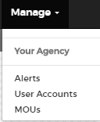
User Management – Level 1 users
Agency administrators are responsible for editing permission levels for Level 1 users
Click Manage >Your Agency> User Accounts

Slide 23
User Management – Level 1 users
Agency administrators are responsible for editing permission levels for Level 1 users
Click Manage >Your Agency> User Accounts
Read: All users have a minimum of read privileges. Users with read permission may submit overdoses and view data for their agency
Write: Users with write privileges may edit entries for their entire agency
Admin: Administrator may designate additional admins, who will have the same abilities as the original administrator

Slide 24
User Management – Level 1 users
Disabling Accounts
If a user should no longer have access to ODMAP Level 1, the administrator has two options for disabling their account; delete or unapprove
Delete
If a user has not entered data into Level 1, their account can be deleted
Unapprove
If a user has entered data into Level 1, their account cannot be deleted. However, their account can be unapproved, removing their ability to access ODMAP

Slide 25
User Management – Level 1 users Approving New User
Assigned Agency Administrator(s) will have to approve a new Level 1 user registering.
A confirmation e-mail will be sent with new registering user details

Slide 26
User Management – Level 1 users Approving New User
Assigned Agency Administrator(s) will approve Level 1 users registering.
An Agency Administrator(s) will approve a new Level 1 user:
Click on Manage>User Accounts>Unapproved Level 1 Users
Please either Approve new registered Level 1 user(s) or Delete user(s)

Slide 27
Managing ODMAP Account
Users are able to update their profiles or change their passwords via the “Account” drop down

Slide 28
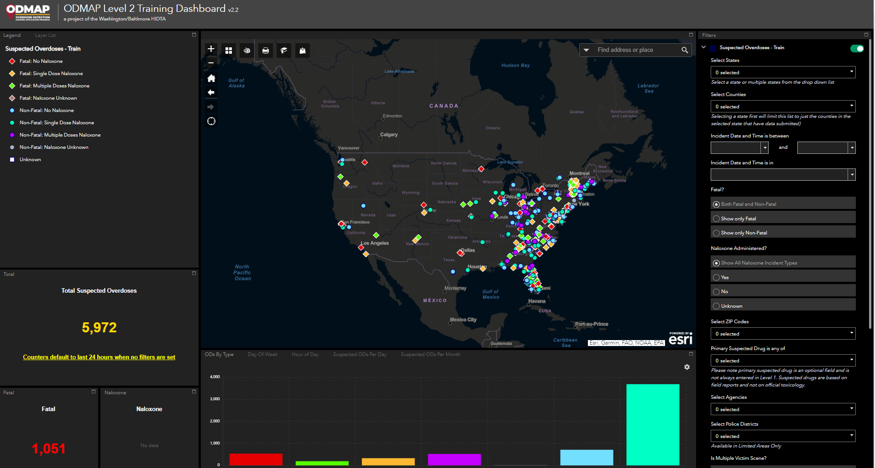
ODMAP Level 2
The ODMAP Level 2 dashboard is a web-based application, which is designed to facilitate real-time surveillance of suspected overdoses. The dashboard allows Level 2 users the ability to display and filter locations of suspected overdoses entered by Level 1 users. The system can also be used to identify hot spots of suspected overdoses and spikes throughout the nation. ODMAP Level 2 dashboard is designed as a tool for decision makers to be able to view and analyze the data nationally.
The data displayed is fictitious and for training purposes only

Slide 29
How to register for Level 2
Agency administrators have the ability to create level 2 users for their agency in 4 easy steps!
Step 1: Click on Manage
Step 2: Click User Account
Step 3: Scroll to the bottom for Level 2
Step 4: Enter in the new users name, email and phone number
*Select Federated Organization User if the user being selected is also a federated partner
Once they agency administrator has created a Level 2 user, an e-mail conformation will be sent to the new user

Slide 30
Alert Management
Create a Spike Alert
Create Overdose Alert
Create Statewide Alert
View active spike alerts
View spike alert history

Slide 31
What is a Spike Alert?
Spike alerts can be set up to notify an agency by email if the total overdoses in an area exceeds a pre-determined threshold within a 24-hour period. Spikes alerts can be established for an agency’s own county, as well as nearby or neighboring counties. By establishing spike alerts for nearby counties the program can serve as an early warning system. If a spike in overdoses occurs in a neighboring area, officials can anticipate a spike in their area and prepare.

Slide 32
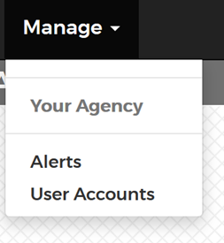
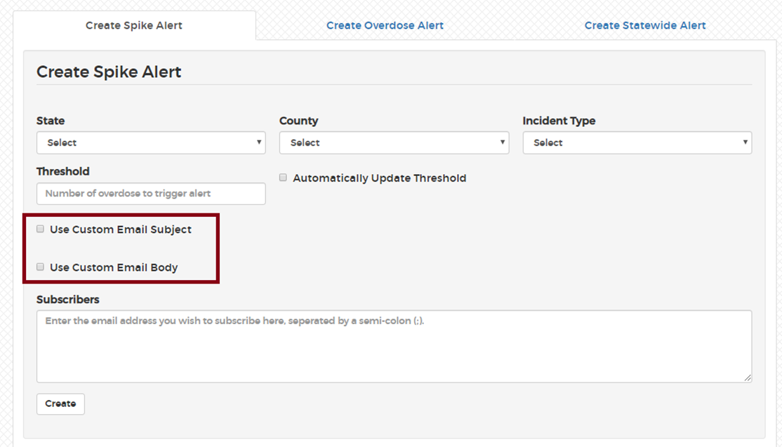
Creating Spike Alerts
Step 1: Select the State of Interest
Step 2: Select the County of Interest
Step 3: Select the Incident Type
Alerts may be setup for only fatal or non-fatal, or for both combined.
Step 4: Enter the Threshold
A spike threshold can be set to any desired number. ODMAP will provide a recommendation for the spike threshold, utilizing a formula of 2 standard deviations above the mean. If a county has not entered data yet, the default recommendation is 3.
Step 5: Create Custom Spike Alert Messages
The administrator can choose to either use the standard ODMAP alert email, or create a custom spike alert email subject, email body or both. This only applies to the initial email that is sent when a spike starts.
Step 6: Enter Subscribers
The administrator may list as many subscribers as they deem appropriate. It is recommended to include police chief, fire/EMS chief, local health officer, and any others who play a key role in responding to a sudden increase in overdoses.
Step 7: Automatically Update Threshold
By checking this box, the threshold will automatically adjust as the ODMAP recommended value changes, based on entered data.

Slide 33
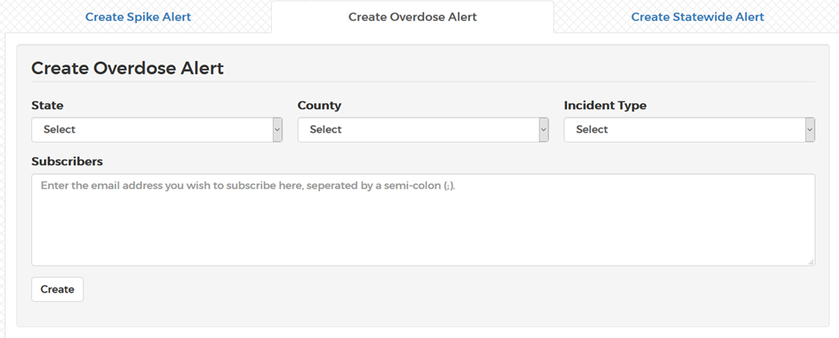
Creating Overdose Alerts
An overdose alert can be created to send an email each time an overdose is entered for a specific county
Step 1: Select the State of Interest
Step 2: Select the County of Interest
Step 3: Select the Incident Type
Alerts may be setup for only fatal or non-fatal, or for both combined
Step 4: Enter Subscribers
The administrator may list as many subscribers as they deem appropriate

Slide 34
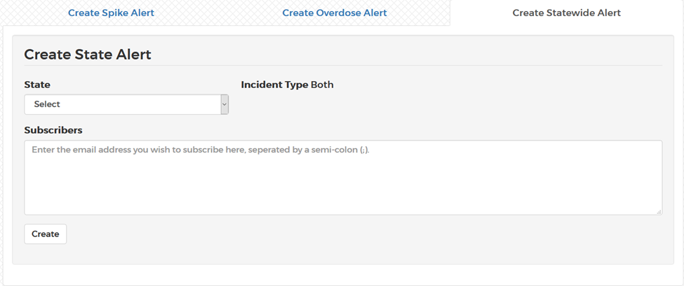
Creating Statewide Alerts
Alerts can be created for when any county in a state experiences a spike. For a statewide alert the ODMAP spike formula must be used. The threshold will be automatically updated according to data submitted. Statewide alerts must also be for both fatal and non-fatal.
Step 1: Select the State of Interest
Step 2: Enter Subscribers
The administrator may list as many subscribers as they deem appropriate

Slide 35
Establishing Memorandums of Understanding (MOU)
Agencies may now share data between their agencies. By signing a Memorandum of Understanding (MOU) agencies can provide one another with Level 1 Read access to their data. To initiate this process, the administrator can complete the following steps:
Go to “Manage” and select “MOU”
The administrator’s agency will automatically populate the Agency 1 section, with that Agency’s Signor information
Select the Agency you would like to establish the MOU with, from the “Agency Name” dropdown menu.
That Agency’s Signor information will automatically populate the Agency 2 section.
Click send “MOU Request”
Signors from both agencies will receive an email informing them that there has been MOU requesting, with a link to sign the agreement.
Once both Signors have signed the agreement, users from each agency will have read access to one another’s data within 24-48 hours.
Once both Signors have signed the agreement, users from each agency will have read access to one another’s data.
Administrator’s can approved an MOU at anytime

Slide 36
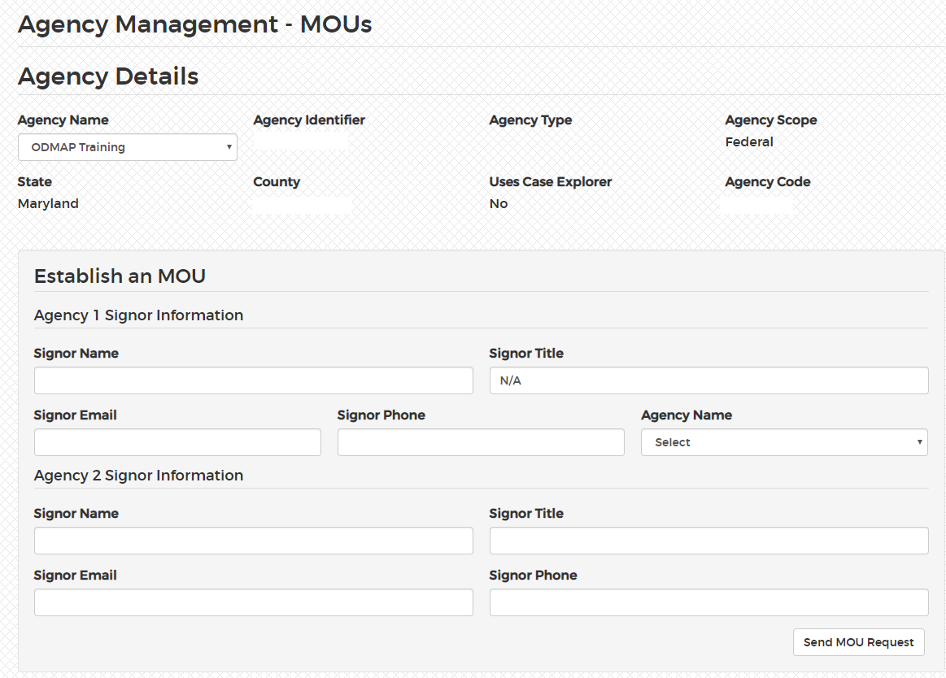
Establishing Memorandums of Understanding (MOU)

Slide 37
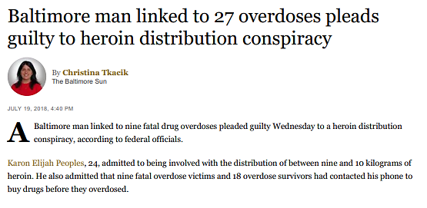
Law Enforcement Success Story
ODMAP assists with prosecution which spanned Maryland, West Virginia, and Pennsylvania.
How did ODMAP & W/B HIDTA Assist?
ODFORM capability within ODMAP serves as centralized data collection, deconfliction, and information sharing
Phone deconfliction through the Communication Analysis Portal (CAP) assisted with 49 seized phones
Partnerships with U.S. Attorney’s Office for the District of Maryland
Partnerships with Federal, State, and Local Law Enforcement
Read More: https://www.justice.gov/usao-md/pr/baltimore-heroin-dealer-linked-27-overdoses-9-them-fatal-sentenced-10-years-federal

Slide 38
Connect with ODMAP
Visit our website
Please visit to our website for the latest materials
http://odmap.org/
Please subscribe to our YouTube Channel for the latest training materials
https://www.youtube.com/watch?v=1WiTfh5suk8
YouTube channel contains the following videos:
Overview of Level 1 platform to include Administrator capabilities
Overview of creation and implementation of spike alerts
Overview of level 2 platform
ODMAP and Public Health
Home screen shortcut
ODMAP website contains the following:
Policies and Procedures
Overdose Spike Response Framework
Participating Agency Map
ODMAP Training
Training Manual
FAQ
Gaining agency access
Tutorial for Law Enforcement
Tutorial for Fire/EMS

