Slide 1
Washington/Baltimore High Intensity Drug Trafficking Areas (W/B HIDTA)
Agency Training

Slide 2
What is ODMAP?
The Overdose Detection Mapping Application Program (ODMAP) provides
Near real-time suspected overdose surveillance data across jurisdictions to support public health and public safety efforts
Facilitates near real-time data sharing and timely responses to changes in overdose patterns such as a sudden increase, or spike in overdose events

Slide 3
ODMAP Levels
ODMAP Level 1
ODMAP Level 2
Entering suspected overdoses
Managing suspected overdoses
User Management
Alert Management
ODFORM
MOU Management
National Map
Ability to analyze data

Slide 4
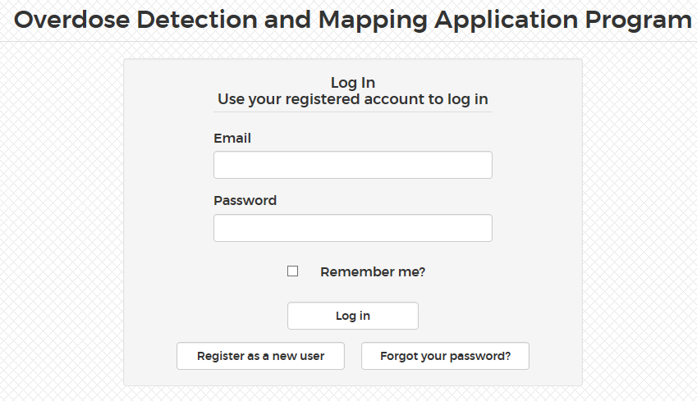
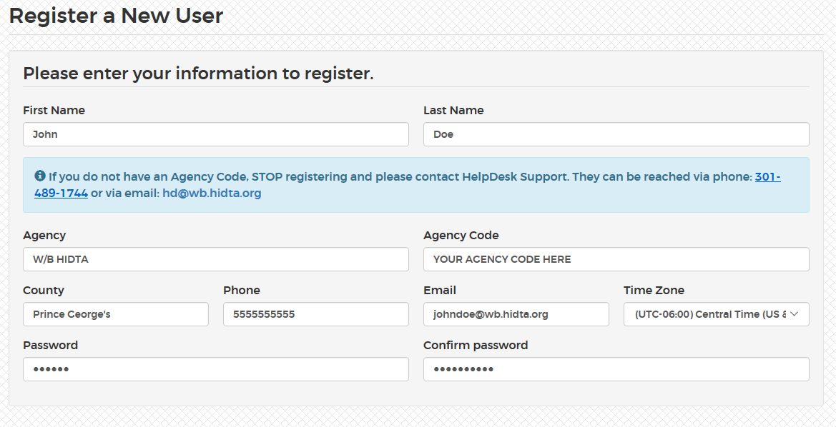
How to register for Level 1?
Navigate to: https://odmap.hidta.org/Account/Login?ReturnUrl=%2F
Click: Register as a new user
Enter all your information
Your agency code is required – if you do not know your agency code, please contact the agency administrator
Scroll ALL the way to bottom and click register

Slide 5
How to register cont.
Once you click register, you will receive a confirmation page
Check your email to confirm your account

Slide 6
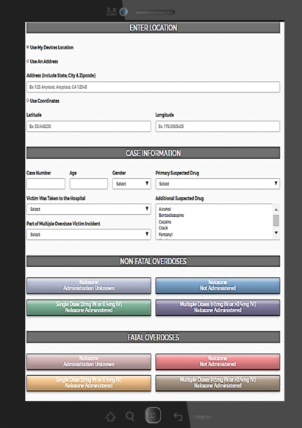
How to use ODMAP at a scene
If a user is using ODMAP though their vehicle:
First responders may create a shortcut to the website through mobile phones and tablets. Please visit https://www.youtube.com/watch?v=qQSzWjl8fRk to learn how. Users are also able to access ODMAP through their Mobile Desktop Terminal (MDT).
Navigate to: https://odmap.hidta.org
Enter in your login credentials and allow the system to remember your credentials
You will be prompted to our home screen, which allows the user to enter the suspected overdose information
ODMAP Level 1 has the ability to the log the location through my devices location
The user is able to submitted preliminary information on scene and edit the entry point later, if needed

Slide 7
ODMAP Level 2
The ODMAP Level 2 dashboard is a web-based application, which is designed to facilitate real-time surveillance of suspected overdoses. The dashboard allows Level 2 users the ability to display and filter locations of suspected overdoses enter by Level 1 users. The system can also be used to identify hot spots of suspected overdoses and spikes throughout the nation. The ODMAP Level 2 dashboard is designed as a tool for decision-makers to be able to view and analyze the data nationally.
Level 1 and Level 2 have been designed to be used on a laptop, desktop and tablets.

Slide 8
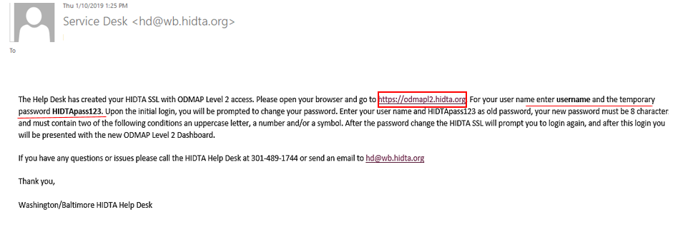
How to register for Level 2
Agency administrators have the ability to create level 2 users for their agency in 4 easy steps!
Step 1: Click on Manage
Step 2: Click User Account
Step 3: Scroll to the bottom for Level 2
Step 4: Enter in the new users name, email and phone number
*Creating a new user may take 1 to 2 business days
Once they agency administrator has created a Level 2 user, an e-mail conformation will be sent to the new user

Slide 9
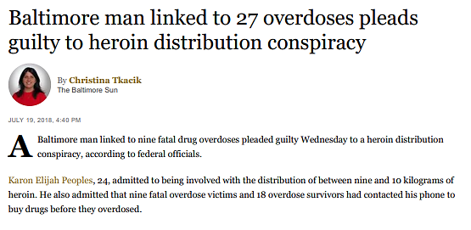
Law Enforcement Success Story
ODMAP assists with prosecution which spanned Maryland, West Virginia, and Pennsylvania.
How did ODMAP & W/B HIDTA Assist?
ODFORM capability within ODMAP serves as centralized data collection, deconfliction, and information sharing
Phone deconfliction through the Communication Analysis Portal (CAP) assisted with 49 seized phones
Partnerships with U.S. Attorney’s Office for the District of Maryland
Partnerships with Federal, State, and Local Law Enforcement
Read More: https://www.justice.gov/usao-md/pr/baltimore-heroin-dealer-linked-27-overdoses-9-them-fatal-sentenced-10-years-federal

Slide 10
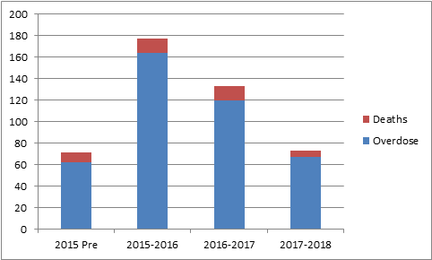
Behavioral & Public Health Success Story
Erie County, NY
The Erie County Health Department utilizes ODMAP as a tool to identify treatment referrals. Health Department staff members monitor ODMAP for new points throughout the county and interfaces with local police who provide a copy of the police report. The Health Departments Peer Recovery Specialist then goes to the overdose victim’s home with a police officer and discusses treatment options. In the first 90 days of this program, 47% of referrals remain connected to care after 30 days.
Notes:
One of the most important components of ODMAP is to isolate how drugs are moving throughout a specific region
We want to see how they are moving in order to better track them.

Slide 11
Connect with ODMAP
Visit our website
Please visit to our website for the latest materials
http://odmap.org/
Please subscribe to our YouTube Channel for the latest training materials
https://www.youtube.com/watch?v=1WiTfh5suk8
YouTube channel contains the following videos:
Overview of Level 1 platform to include Administrator capabilities
Overview of creation and implementation of spike alerts
Overview of level 2 platform
ODMAP and Public Health
Home screen shortcut
ODMAP website contains the following:
Policies and Procedures
Overdose Spike Response Framework
Participating Agency Map
ODMAP Training
Training Manual
FAQ
Gaining agency access
Tutorial for Law Enforcement
Tutorial for Fire/EMS

